Slide 1
3 Axis Pin Dev. Update
Week #21

Slide 2
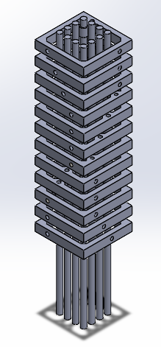
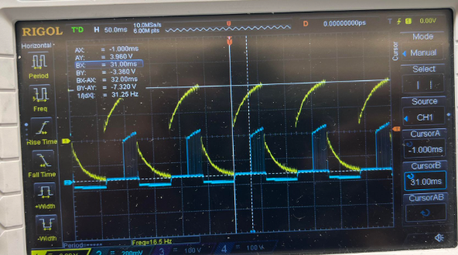
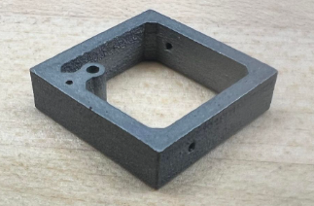
Last Week!
Metal Frames came in (a little heavy, and pins would slide inside the hole, instead of moving the frame up and down)
DC Micro Gear Motor has low bandwidth (~30Hz for 20Hz input signal)

Slide 3
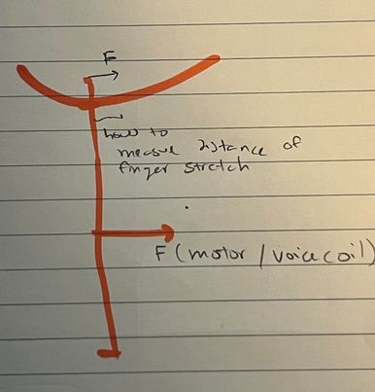
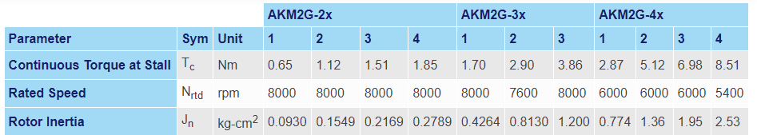
Motor Requirements / Hunting
We are actuating the pin array from ~20 - 300Hz
Motor bandwidth needs to be 300Hz~
Low Frequencies: Displacement ~1mm
High Frequencies: ~0.05 mm (sort of arbitrarily chose it)
Looked into / Called a couple companies
Kollmorgen (AKM series motors)
Aerotech (haven’t gotten back yet)

Slide 4
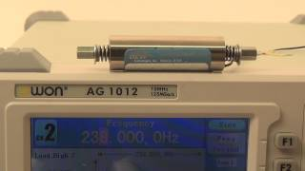
Motor Hunting
H2Wtech
Input Sinusoidal Acc.
300 Hz
~0.05 mm open
~0.11 mm closed

Slide 5
3 Axis Pin Dev. Update
Week #20

Slide 6
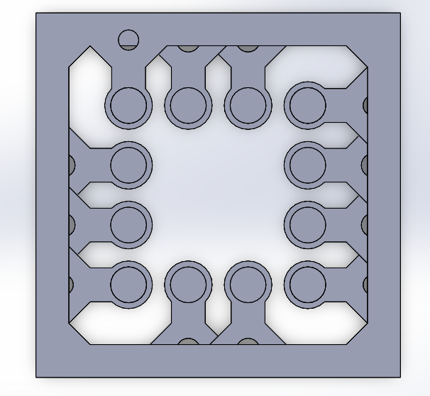
Production updates!
Cons:
Somewhat heavy!
A little too thick
Pin hole is slightly larger
than expected
Pros:
Might work!
Looks Cool!

Slide 7
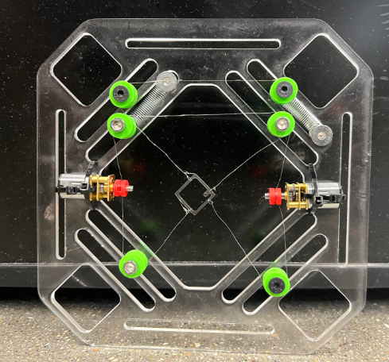
Last Week!
Sprung (not really) Pulley
Wire crimps a little

Slide 8
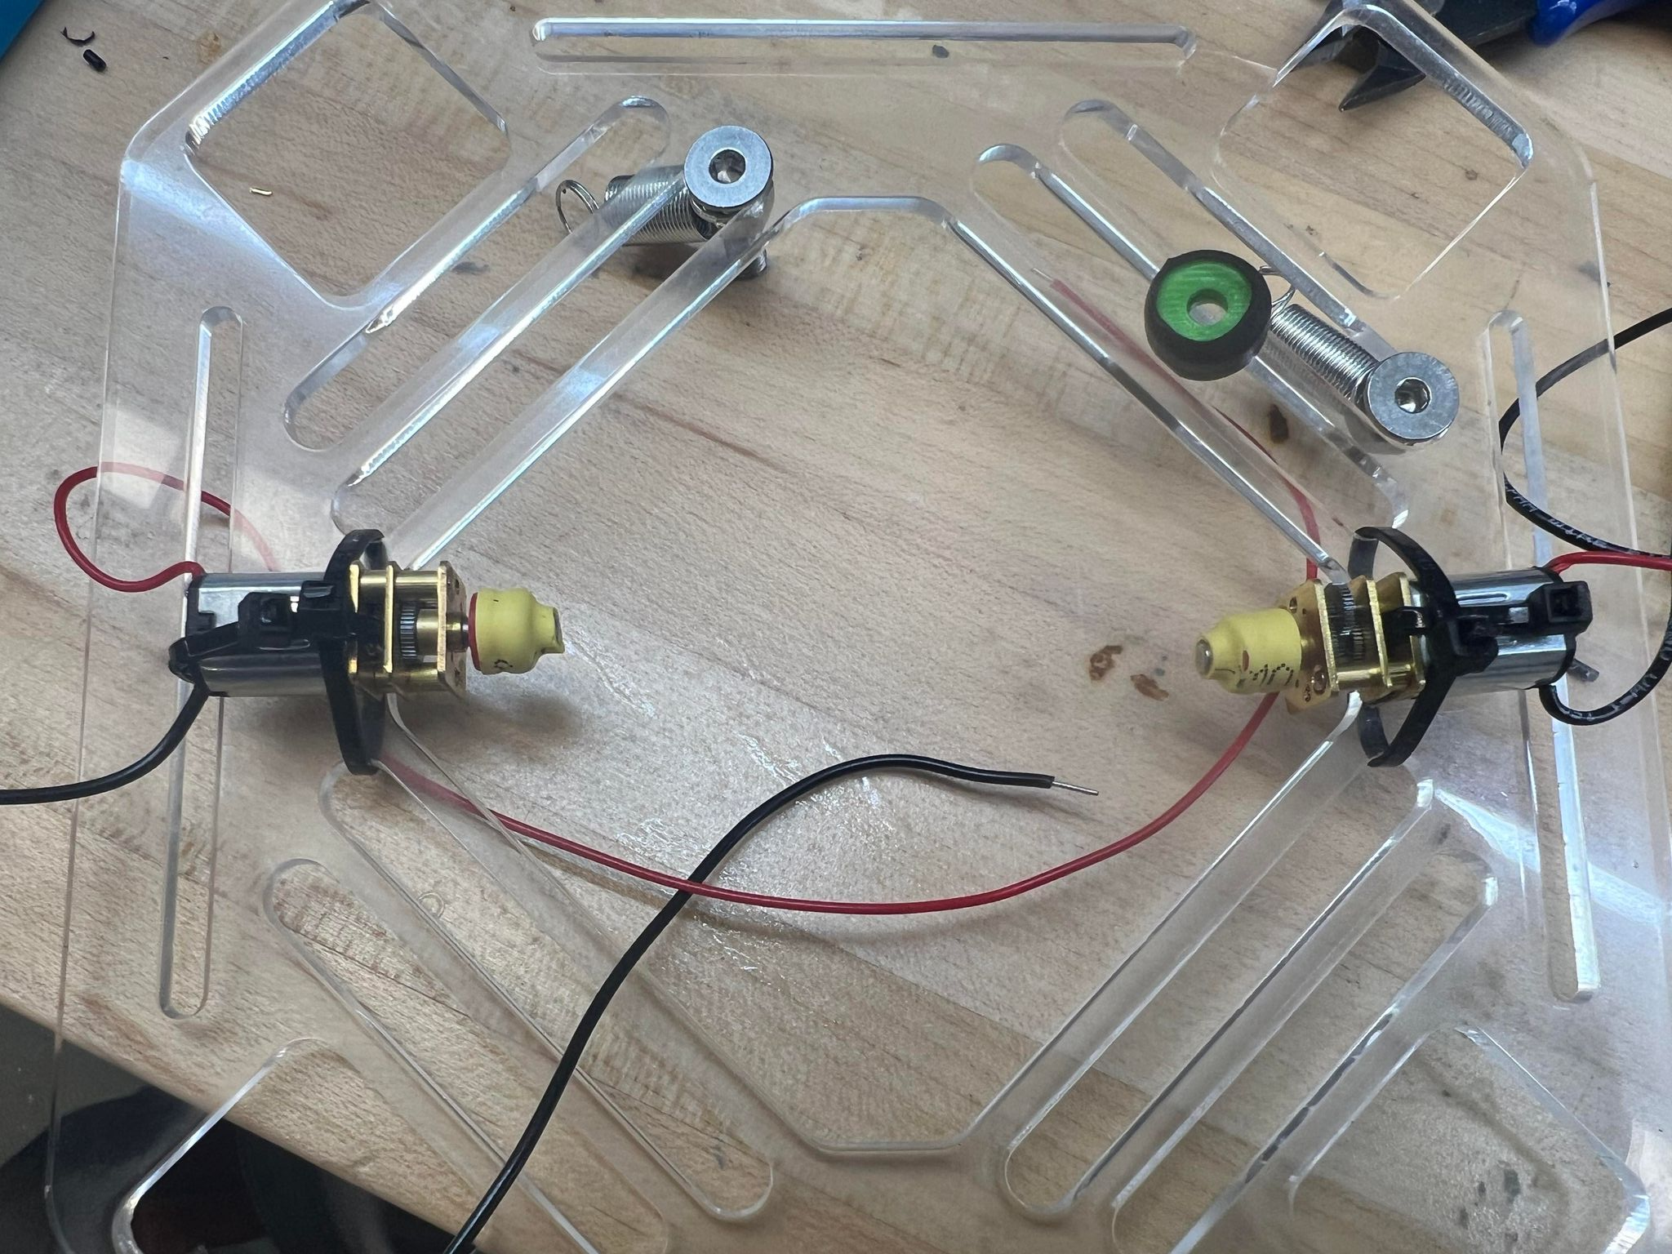
Some Updates
Added some heat shrink around pulleys for friction against strings
Using the RDS capstan string
Need to check how weight of frame affects ‘dip’ and if a lot of tension from spring can counteract that

Slide 9
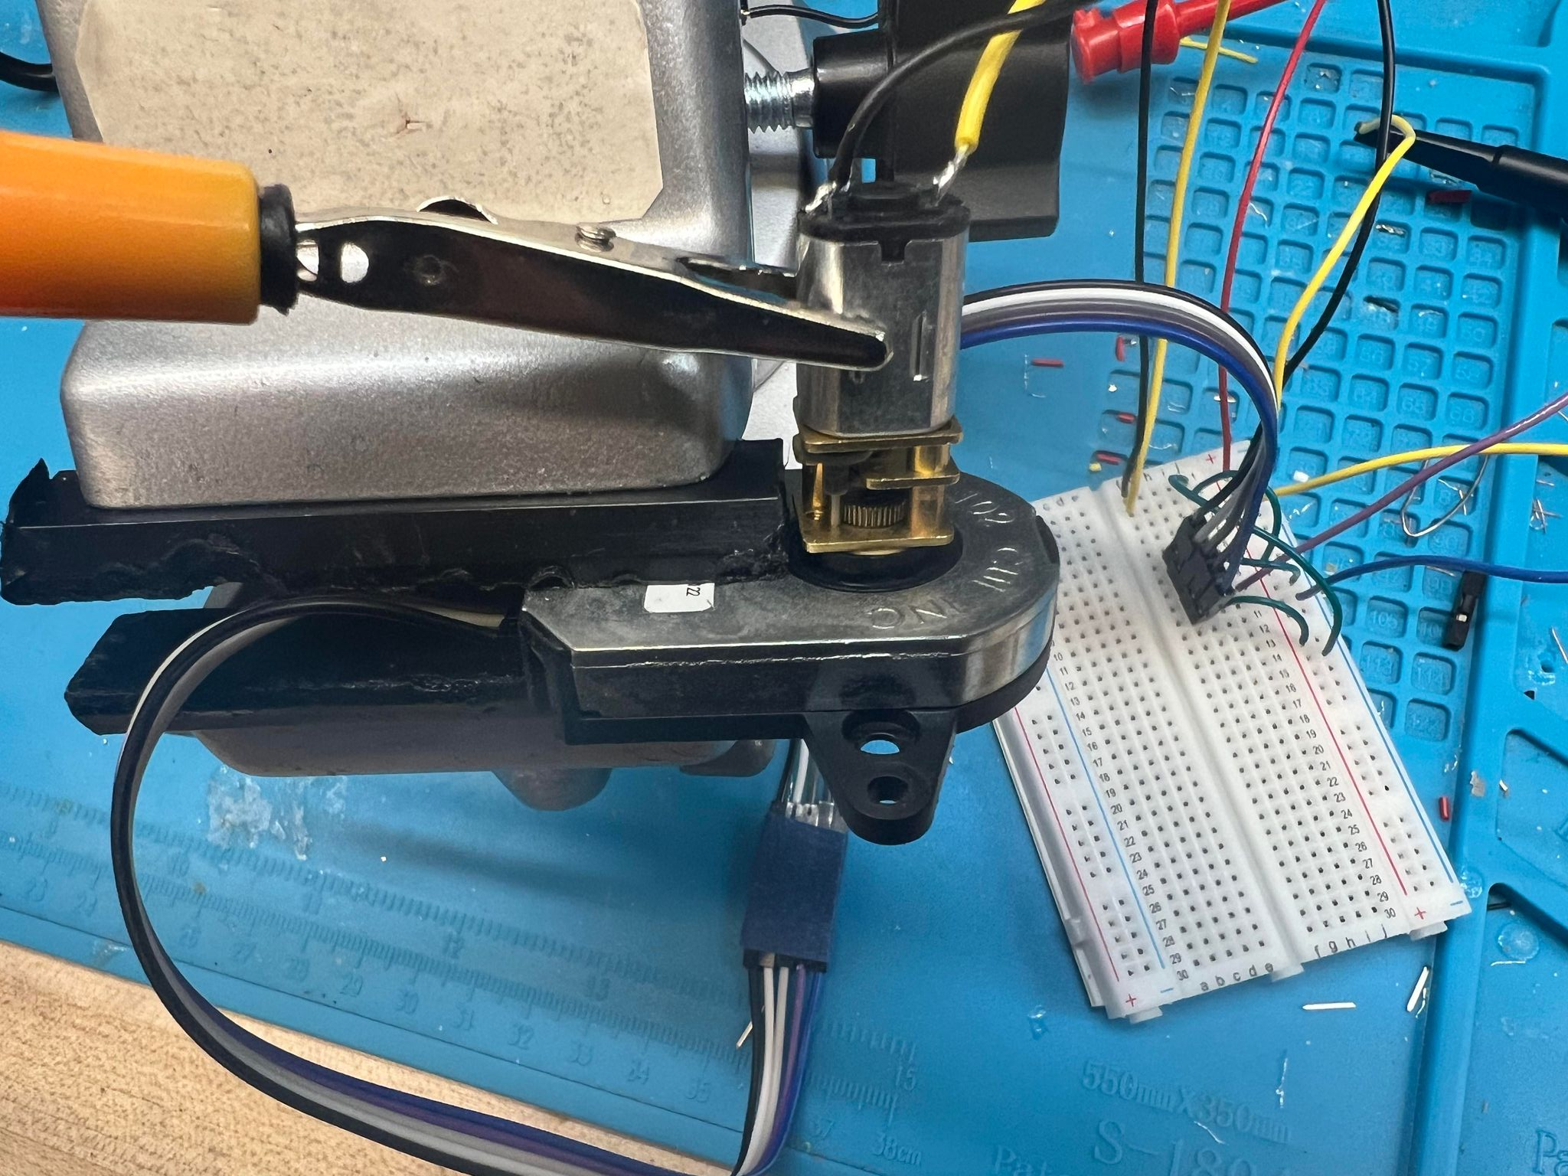
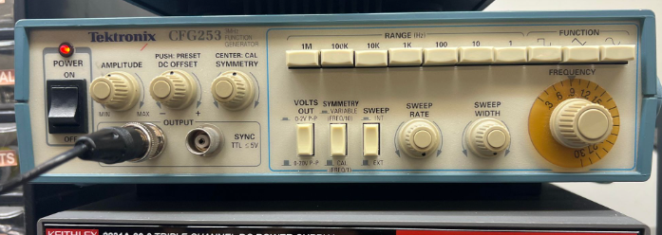
Bandwidth Tests
Optical Encoder connected to micro gear motor
Sent in various square waves at different frequencies / voltages to the motor
Measured how long it takes for encoder to read signal (should be equivalent to the motor’s latency)

Slide 10
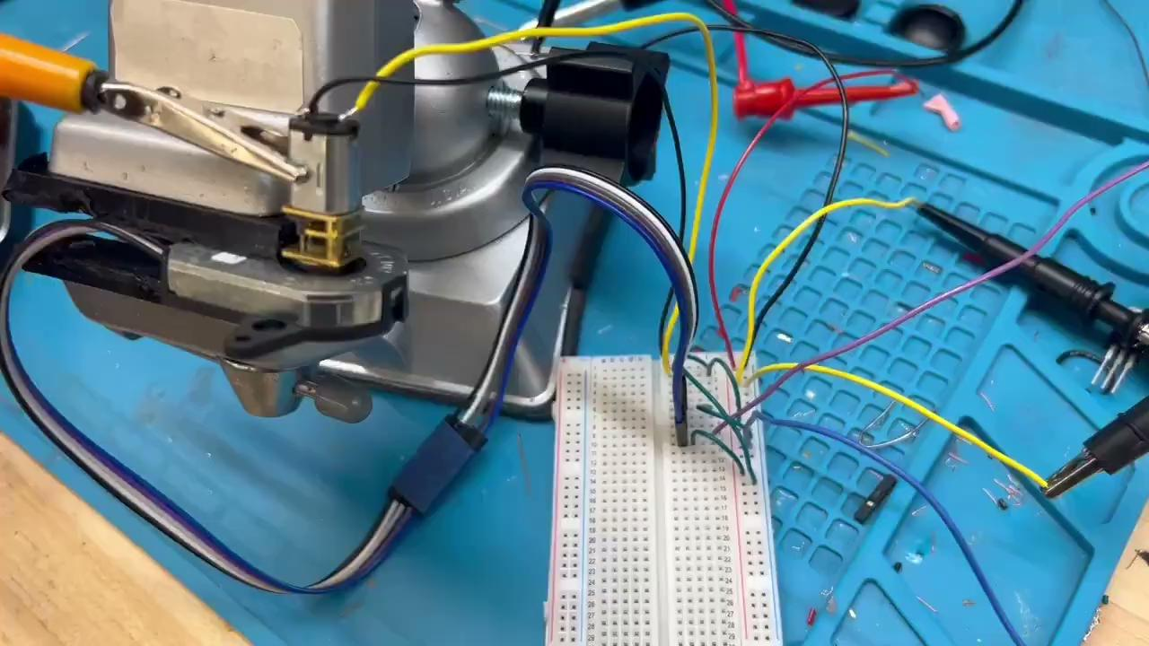
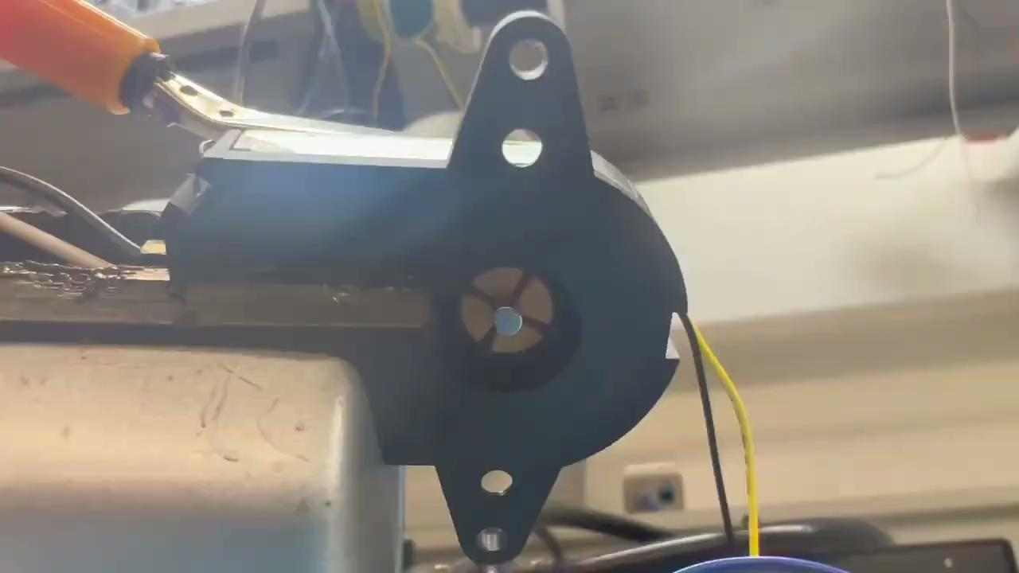
How it looksies!

Slide 11
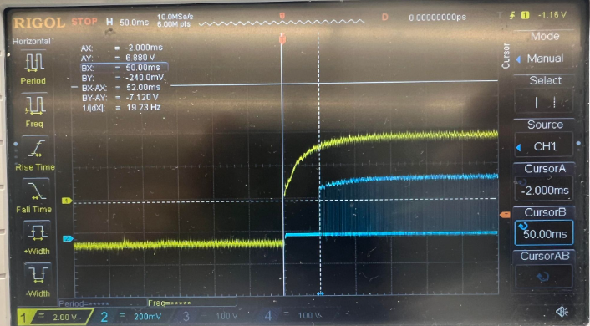
Bandwidths for ~10Hz Input Signal

Slide 12
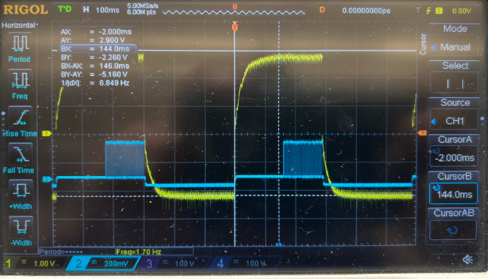
Bandwidths for ~20Hz Input Signal

Slide 13
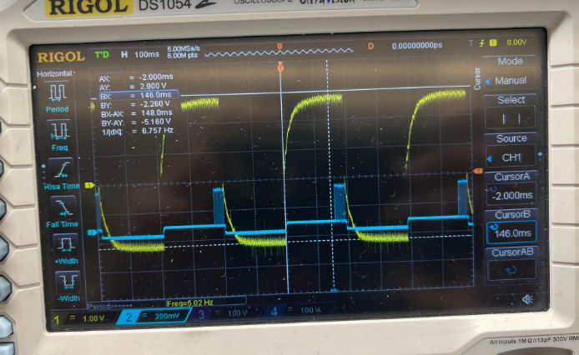
Bandwidths for ~20Hz Input Signal

Slide 14
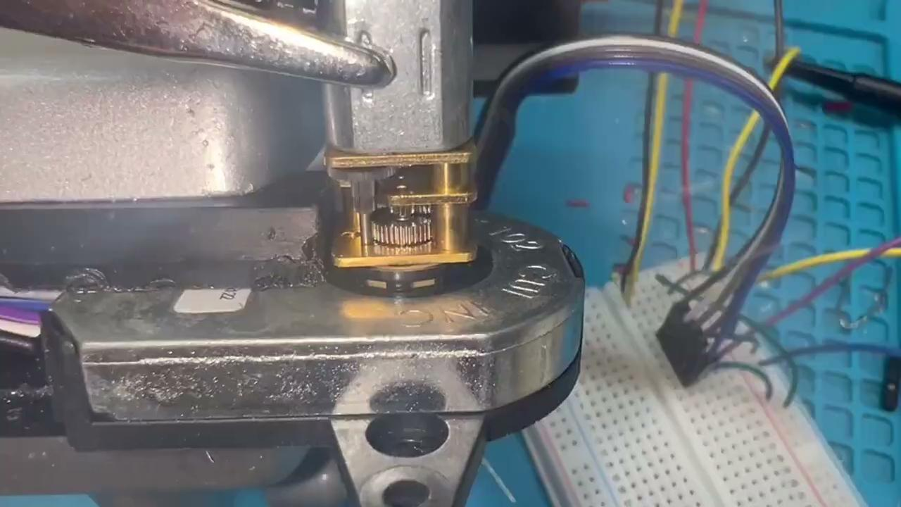
Bandwidths for ~30Hz Input Signal

Slide 15
3 Axis Pin Dev. Update
Week #19

Slide 16
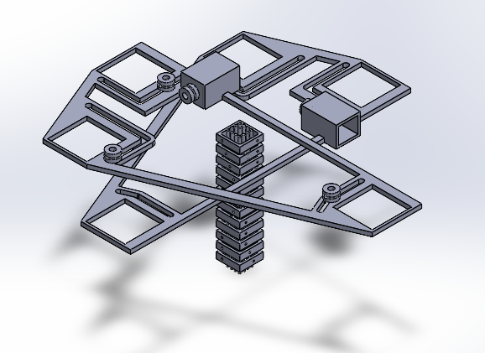
Last Week: Stackable Frame Mounts

Slide 17
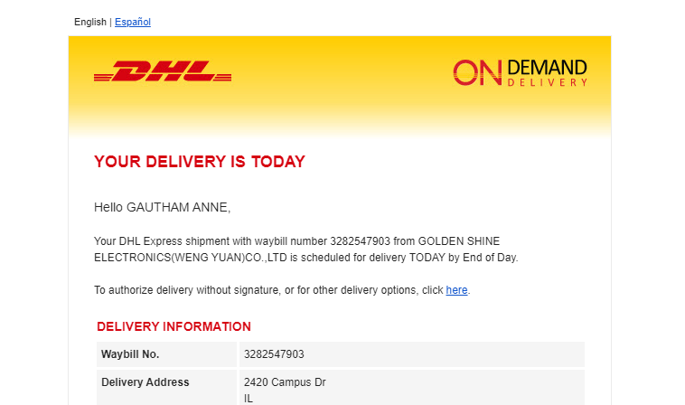
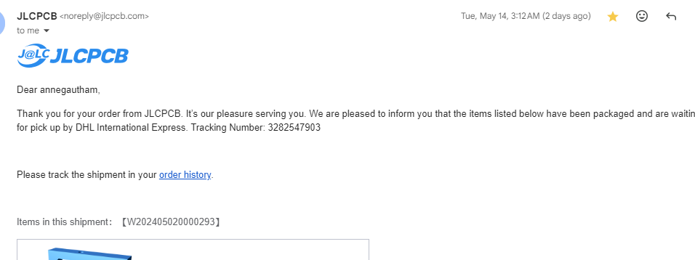
Production updates!

Slide 18
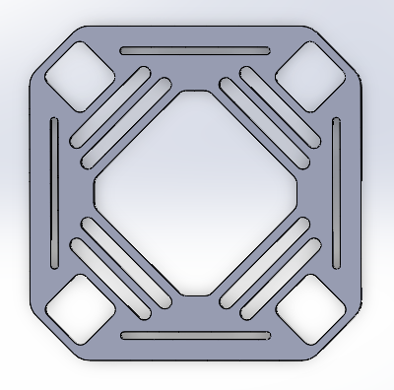
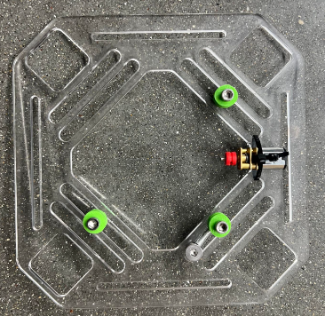
Version 2

Slide 19
Sprung Pulley
Wire crimps a little

Slide 20
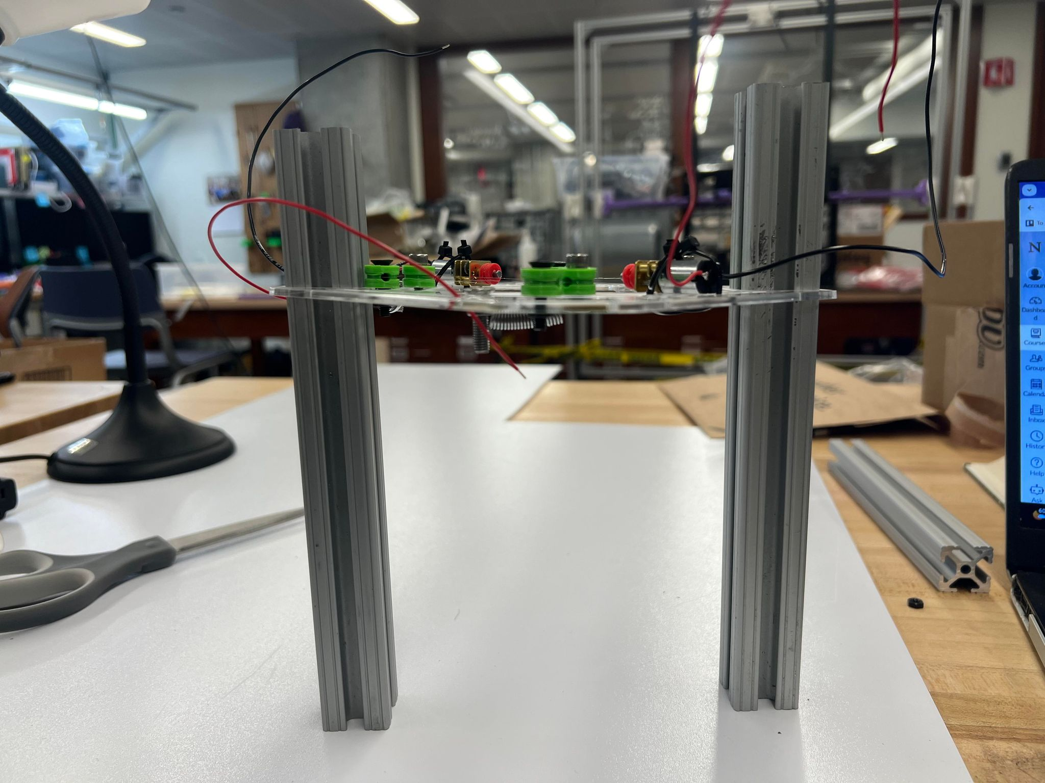
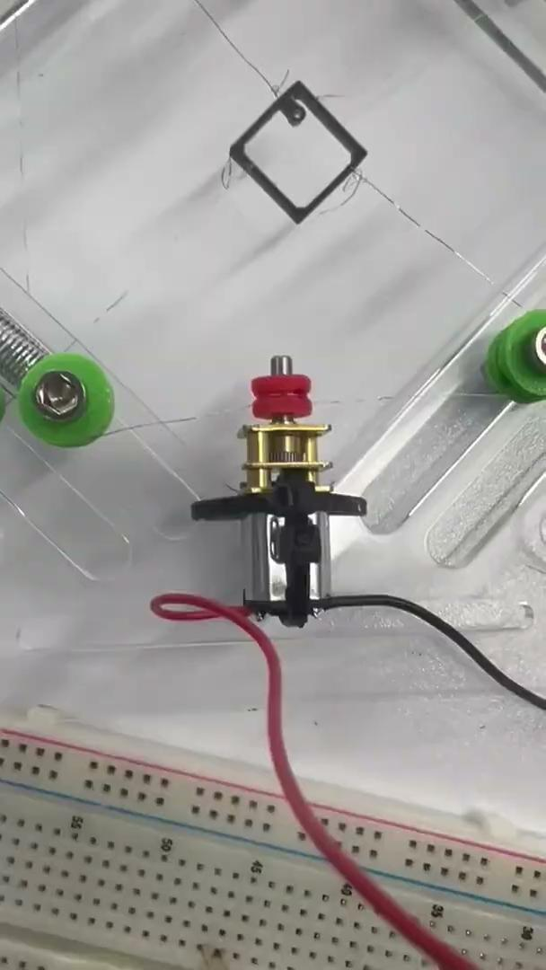
Current height between frames is 8 mm, meaning we would be actuating the bottom most frame/pin at 3 + 11*8 = 91 mm
Want to bring this down to 4 mm, so we would actuate bottomost frame/pin at 3 + 4*11 = 47 mm

Slide 21
3 Axis Pin Dev. Update
Week #18

Slide 22
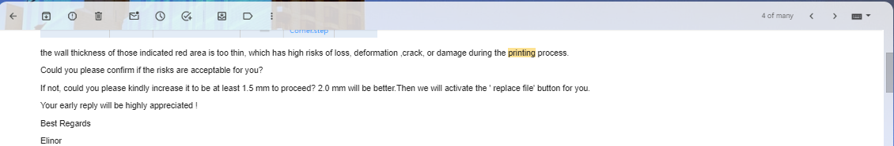
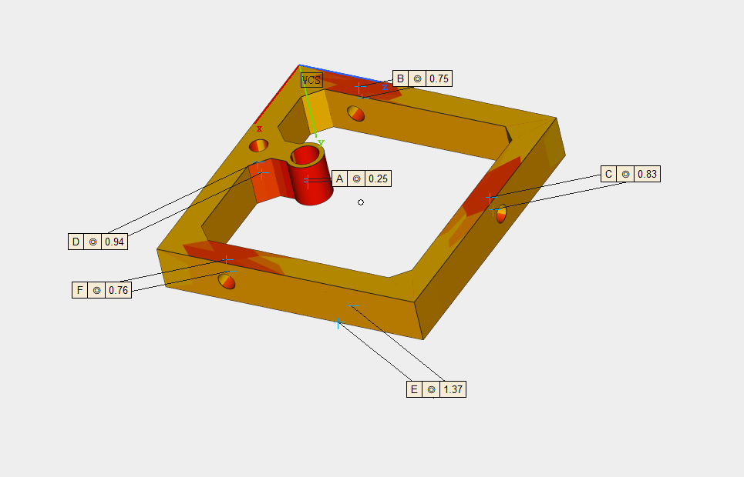
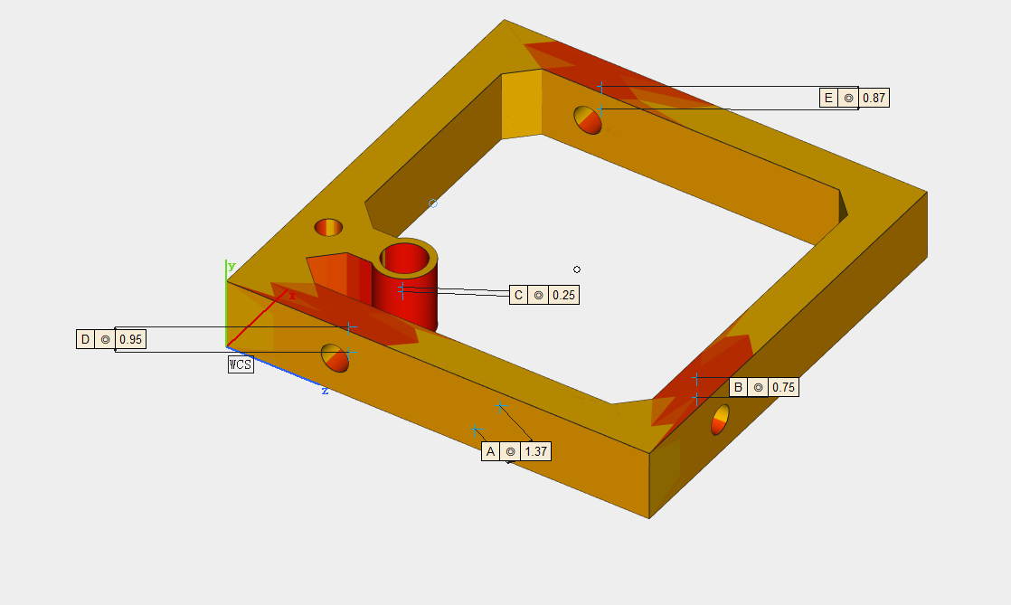
Production updates!

Slide 23
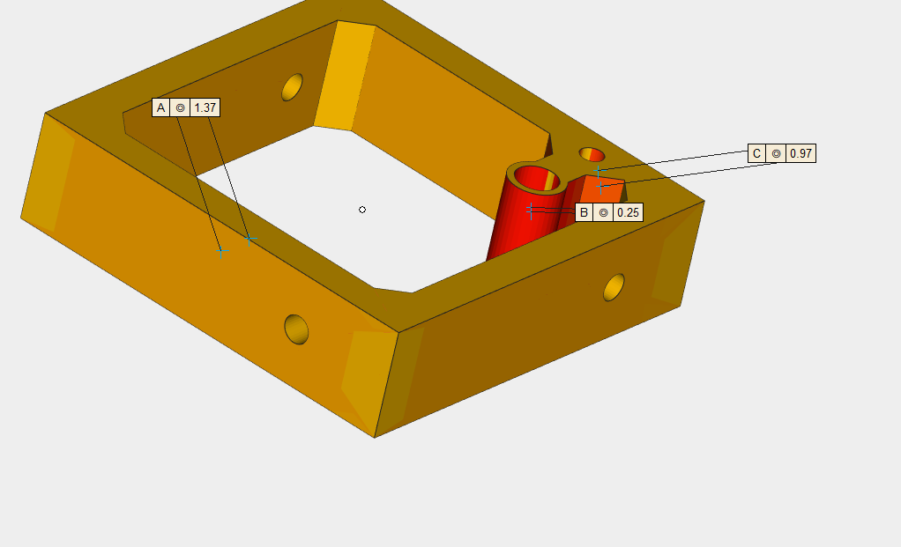
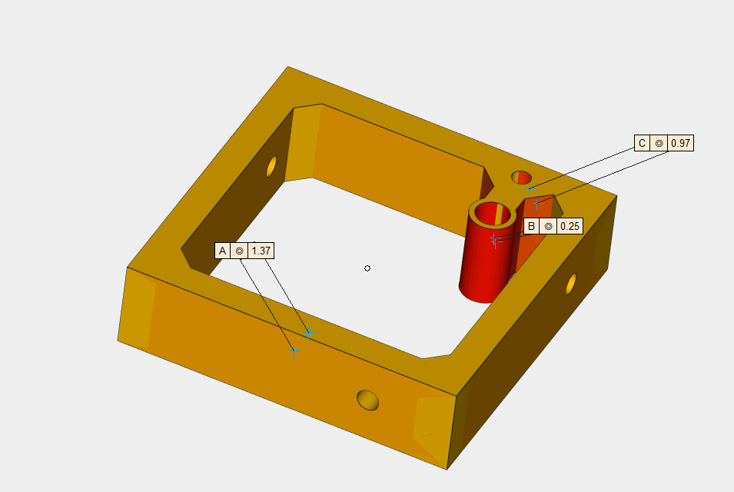
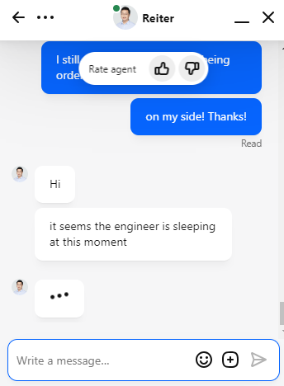
Production updates…

Slide 24
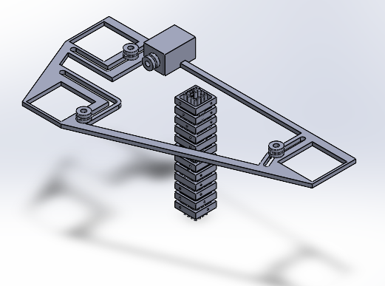
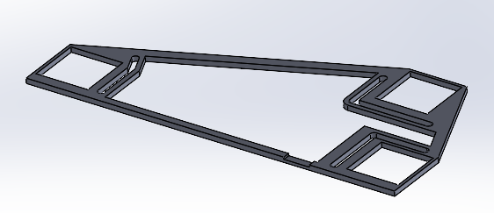
Design Updates…

Slide 25
3 Axis Pin Dev. Update
Week #17

Slide 26
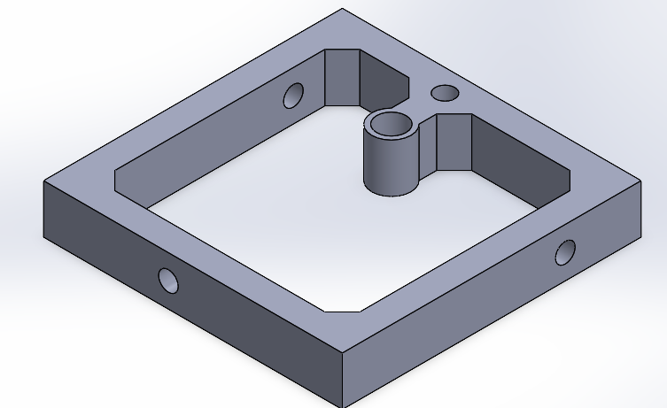
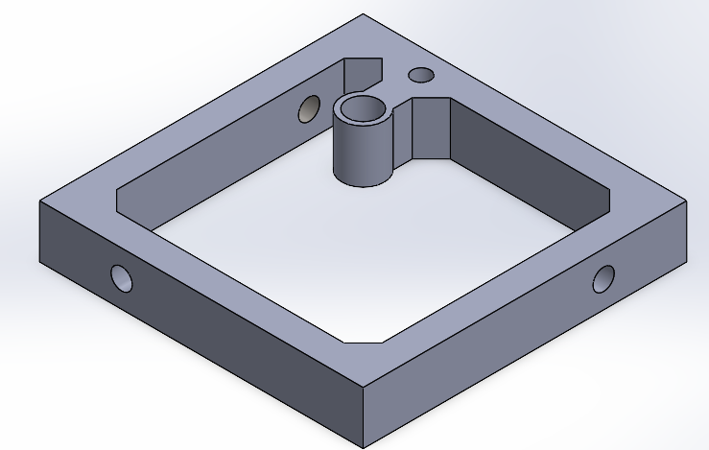
Ordered Rigid Frames through JLC …
316L Stainless Steel, should be here tmrw
EDM @ the research shop?
Need NUCore Account to submit requests
In case print comes out ‘clumpy’

Slide 27
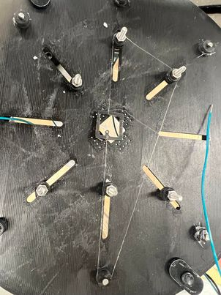
1 Motor 1 Frame Stringing

Slide 28
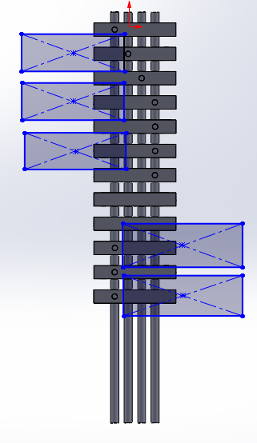
Motor Placement

Slide 29
Old Placement

